Slide 1
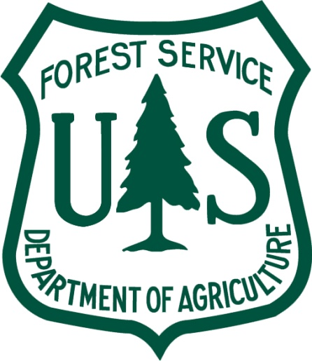
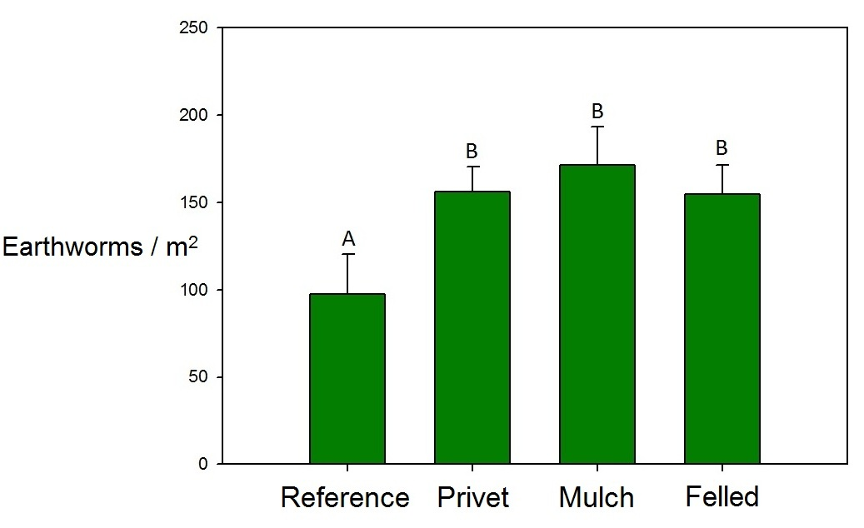
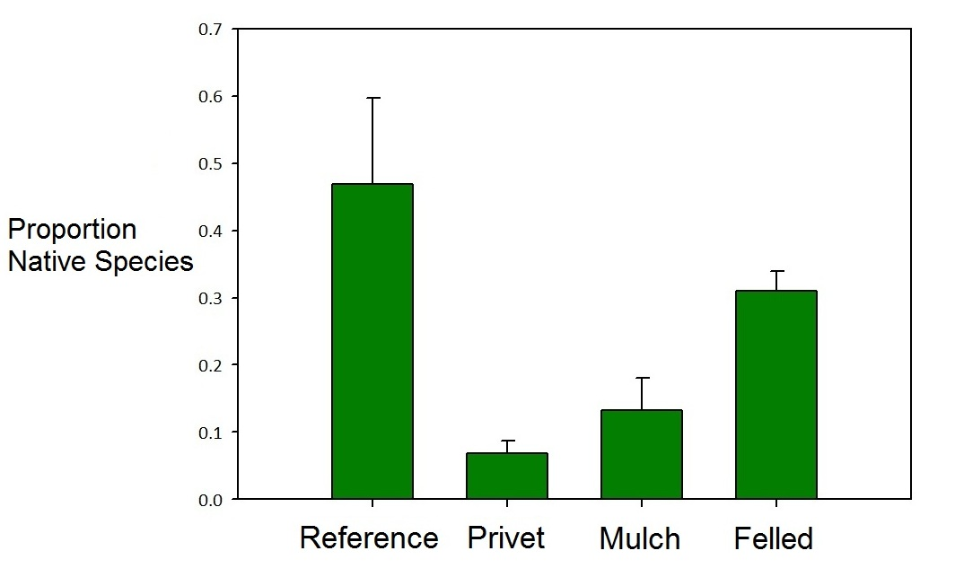
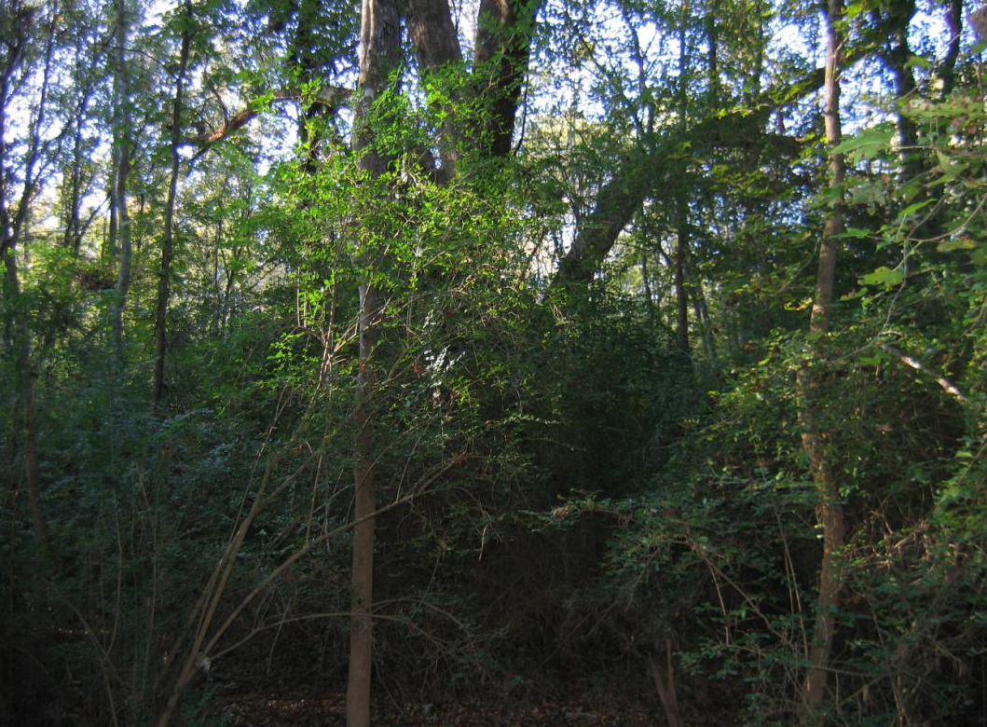
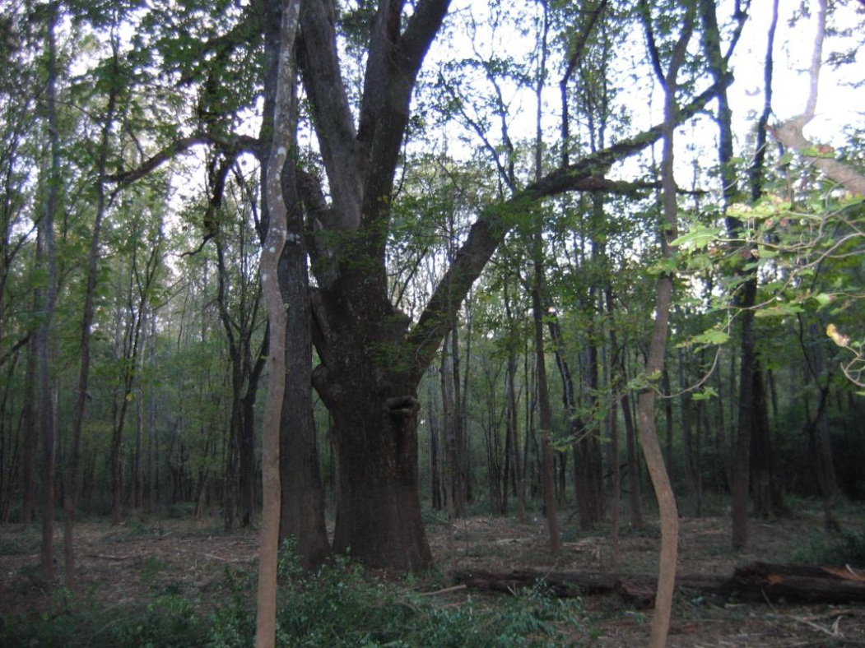
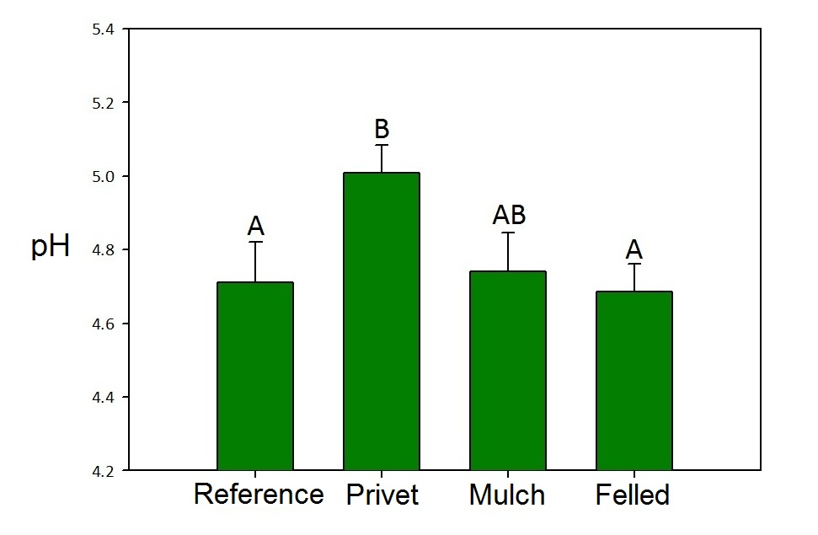
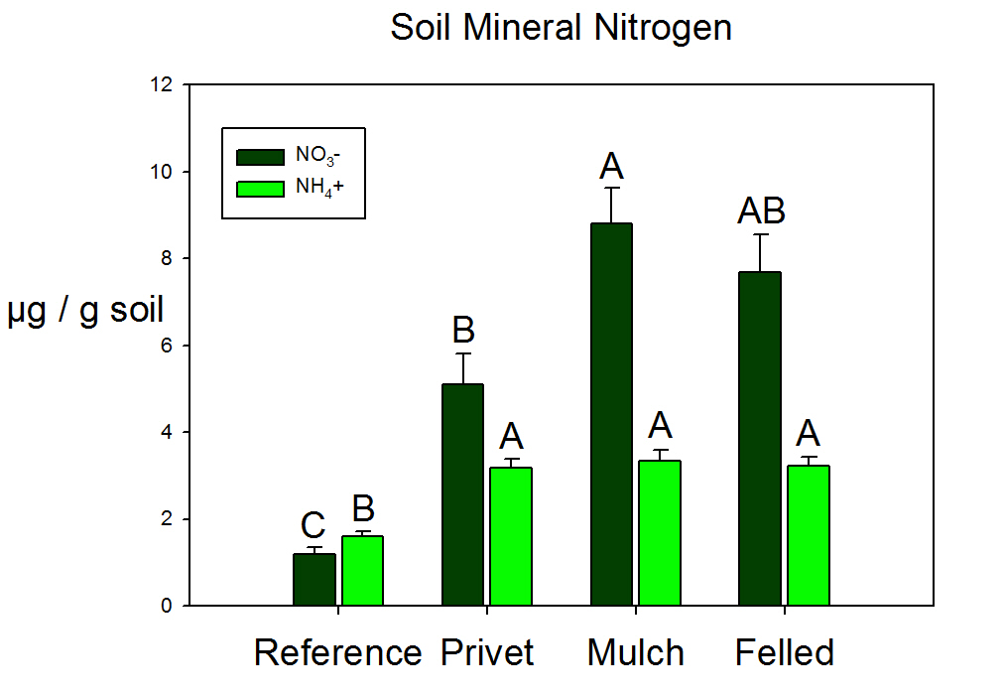
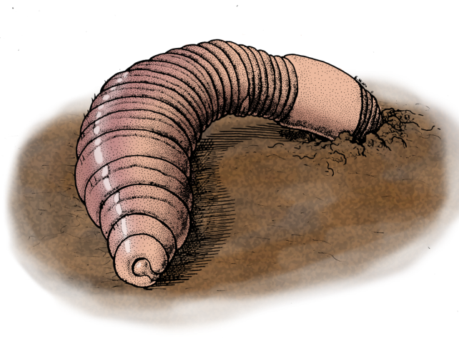
Removal of invasive shrubs (Ligustrum sinense) reduces invasive earthworm abundance and promotes recovery of native earthworms
Joshua W. Lobe¹, Paul F. Hendrix¹, *Mac A. Callaham, Jr. ², and James L. Hanula²
¹Odum School of Ecology, University of Georgia, Athens, GA 30602
²USDA Forest Service, Southern Research Station, 320 Green St., Athens, GA 30602
*contact: mcallaham@fs.fed.us
Introduction
It is believed that invasive shrubs can facilitate the invasion of other invasive species, including earthworms. This may occur through alterations of soil properties and increased nutrient availability brought about by the invasive plants.
Currently, it is unknown how invasive plants, and their removal, affect native earthworm populations. This study aimed to answer questions specifically concerning how the invasive shrub, Chinese privet (Ligustrum sinense Lour.), affects both native and exotic earthworm populations. Specific hypotheses include:
(1) Privet invasion increases earthworm abundance
(2) Privet invasion benefits exotic earthworm
species to the detriment of native species
(3) Native earthworm populations recover
following the removal of the invasive shrub
Figure 4. Earthworm densities remain elevated following privet removal
Figure 5. Relative abundance of native earthworms increases following privet removal
Introduced European earthworms were more dominant in the earthworm community under privet cover, and privet removal reduced their relative abundance in the community. Conversely, the relative abundance of native species (principally Diplocardia michaelsenii), was highest in the reference plots (never invaded by privet), and D. michaelsenii represented a larger proportion of the community in privet removal plots (Figure 6).
 | Species Richness | Shannon Index e^{H´} | Evenness J'
Reference | 7 | 4.181 | 0.6880
Privet | 6 | 3.070 | 0.5394
Mulch | 8 | 4.093 | 0.6777
Felled | 8 | 4.774 | 0.7518
Table 1. Earthworm diversity increases following privet removal, returning to reference levels
Figure 1. Site before and after privet removal
Materials and Methods
In 2006, privet removal treatments were applied to four sites in northeastern
Georgia, USA (Figure 1)
There were four treatments: 1) privet removal by hand felling, 2) privet
removal by mechanical mulching, 3) privet ‘control’ where privet stands were
not treated, and 4) a reference condition ‘control’ where privet had never
occurred.
Earthworm sampling was conducted four times over the course of one year at
four points within each plot.
Sampling consisted of hand sorting the soil and litter from 30x30x30 cm pits.
Soil cores were taken at each point in September of 2010 and were analyzed
for pH, mineral nitrogen, and potential nitrogen mineralization.
Earthworm abundances were compared using a Kruskall-Wallis ANOVA
because the data were not normal. Data for soil properties were transformed
to satisfy normality assumptions, and then analyzed using an ANOVA.
Results
Figure 6. Relative abundance of all species found for each treatment. Native species are indicated with black type, and exotic species with white type.
Both pH and available nitrogen (NO₃⁻ and NH₄⁺) were higher in privet sites
relative to reference sites.
Conclusions
The results from earthworm community sampling and the soil chemical analysis suggest that privet-mediated effects on soil pH may confer a competitive advantage to European lumbricid earthworms, supporting the idea that privet and exotic earthworms have a facilitative relationship. Furthermore, removal of the invasive shrub appears to reverse the changes in soil pH, and may allow for recovery of native earthworm fauna.
Figure 2. Soil pH recovers to reference levels following privet removal.
Figure 3. Mineral N levels are elevated following privet removal
Higher densities of earthworms were found under privet relative to reference sites.
Privet removal did not lead to a decrease in total earthworm abundance (Figure 4), probably because much of the privet biomass remained at the sites, as evidenced by the increased soil nitrogen levels (Figure 3).
Acknowledgements
Thanks go to the USDA Forest Service Southern Research Station in Athens and the Odum School of Ecology at the University of Georgia for financial support.

